Slide 1
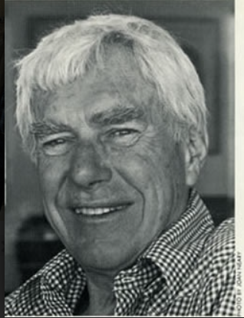
INTERCULTURAL COMMUNICATION: INDIAN, SPANISH, AND PORTUGUESE CULTURES
Based on Edward T. Hall's Cultural Dimensions
TEAM 1:
SHRUTI TOTLA
TIAGO PHILLIPE
EKTA ALIZIA
KUSHAGRADHI MUKHERJEE

Slide 2

INTRODUCTION
This presentation explores intercultural communication between Indian, Spanish, and Portuguese cultures using Edward T. Hall's cultural dimensions.

Slide 3
Indian Culture:
• High-context, relies on implicit cues and relationships.
Spanish and Portuguese Cultures:
• Also high-context but slightly more direct than Indian culture.
High-Context vs. Low-Context Communication
Potential Issues:
• Misinterpretation of indirect messages.
• Differences in nonverbal communication.
Improvement Methods:
• Encourage explicit communication.
• Discuss norms openly to clarify expectations.

Slide 4
Indian Culture:
• Polychronic, flexible with time and multitasking.
Spanish and Portuguese Cultures:
• Somewhat polychronic but with more emphasis on balance.
Time Orientation: Monochronic vs. Polychronic
Potential Issues:
• Differing degrees of flexibility and urgency.
Improvement Methods:
• Establish clear deadlines and align priorities.
• Use tools to manage tasks with flexibility.

Slide 5
Indian Culture:
• May stereotype Spanish and Portuguese cultures as overly expressive.
Spanish and Portuguese Cultures:
• Might stereotype Indians as overly deferential or indirect.
Stereotypes and Prejudices
Potential Issues:
• Prejudices can hinder trust and collaboration.
Improvement Methods:
• Conduct cultural sensitivity training.
• Promote open dialogue to dispel stereotypes.

Slide 6
Indian Culture:
• May hesitate to embrace new communication styles.
Spanish and Portuguese Cultures:
• May experience discomfort adapting to unfamiliar practices.
Anxiety About the 'New'
Potential Issues:
• Resistance to change and misjudging adaptation time.
Improvement Methods:
• Gradual integration of new practices.
• Provide context to ease the transition.

Slide 7

The Tendency to Evaluate Based on One's Own Grid
Indian Culture:
• Prioritizes hierarchical respect and relational harmony.
Spanish and Portuguese Cultures:
• More comfortable with direct feedback.
Potential Issues:
• Feedback styles may clash.
• Differing priorities in evaluations.
Improvement Methods:
• Create shared evaluation frameworks.
• Balance direct feedback with relational sensitivity.

Slide 8

Conclusion
• Understanding cultural dimensions helps navigate intercultural communication.
• Mutual respect, open discussions, and deliberate adaptation are key to overcoming challenges.
• By addressing potential issues proactively, teams can foster effective collaboration.

Slide 9
THANK YOU

