Slide 1

TEAM 1
THE
ART OF
CHOOSING
Bernabé Ríos
Priyanka Mitruka
Filip Stipaničev
Josip Šarić
Anastácia Chihai
David Manuel Matias Isaac

Slide 2

TABLE OF CONTENTS
01
INTRODUCTION
02
CULTURAL DIFFERENCES IN DECISION-MAKING
03
PROBLEMATIC SCENARIOS IN INTERCULTURAL DECISION-MAKING
04
PERSONAL EXPERIENCES
05
CONCLUSION

Slide 3
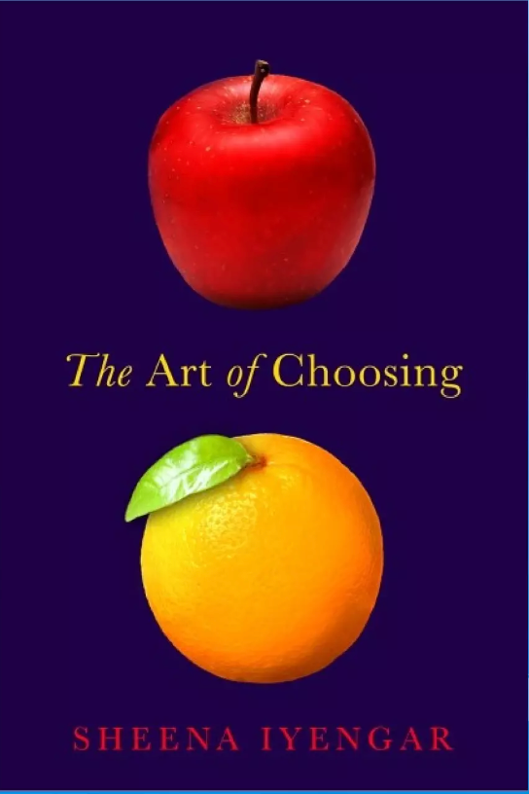
INTRODUCTION
THE TED TALK FOCUSES ON:
  Choices and the surprising things experts have learned about how people make choices.
  The talk gets us thinking about decision-making and gives insight into the personal and cultural differences surrounding choice.
COKE OR PEPSI ?
SAVE OR SPEND ?
STAY OR GO ?
3

Slide 4
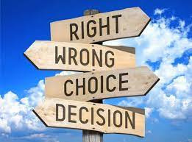
QUESTIONS
  Is the desire for choice innate or driven by culture ?
  Why do we sometimes choose against our best interests ?
  How much control do we actually have over what we choose ?
4

Slide 5
CULTURAL DIFFERENCES IN DECISION-MAKING
CULTURAL VARIATION IN PREFERENCES
WIPO (The World Intellectual Property Organization)
Different cultures have varying degrees of individualism and collectivism, which affects decision-making processes.
PERCEPTION OF CHOICES
The balance between personal autonomy and external control influences how people make choices, and this balance varies across cultures.
IMPACT OF CHOICE OVERLOAD
An abundance of choices can lead to feelings of fear and overwhelm, challenging the American belief that more choices are always better.
5

Slide 6
PROBLEMATIC SCENARIOS IN INTERCULTURAL DECISION-MAKING
DIFFERING DECISION-MAKING NORMS
WIPO (The World Intellectual Property Organization)
Cultural variations in decision-making norms can lead to misunderstandings and conflicts in collaborative projects.
DISAGREEMENTS ON HIERARCHY AND AUTHORITY
Differing opinions on hierarchy and authority in decision-making can cause tension and disagreements among team members.
ETHICAL DILEMMA
Varied cultural norms and values may result in ethical dilemmas, where decisions may be perceived as morally right by one culture and wrong by another.
COMMUNICATION STYLE MISUNDERSTANDINGS
Variations in communication styles, such as direct versus indirect communication, can result in misinterpretations and miscommunications.
6

Slide 7
PERSONAL EXPERIENCES
FRANCE VS US
CULTURAL PERSPECTIVES ON ABORTION
PORTUGAL VS ROMANIA
CULTURAL GREETING ETTIQUTIES
WIPO (The World Intellectual Property Organization)
ITALY VS WORLD:
PIZZA ETIQUETTE: KETCHUP CLASH IN ITALY"
BOSNIA VS WORLD
BOSNIAN BUREK TRADITION: MEAT VS. CHEESE
SPAIN VS NORTHERN EUROPE
CULTURAL GREETINGS - WARM AND PERSONAL
7

Slide 8
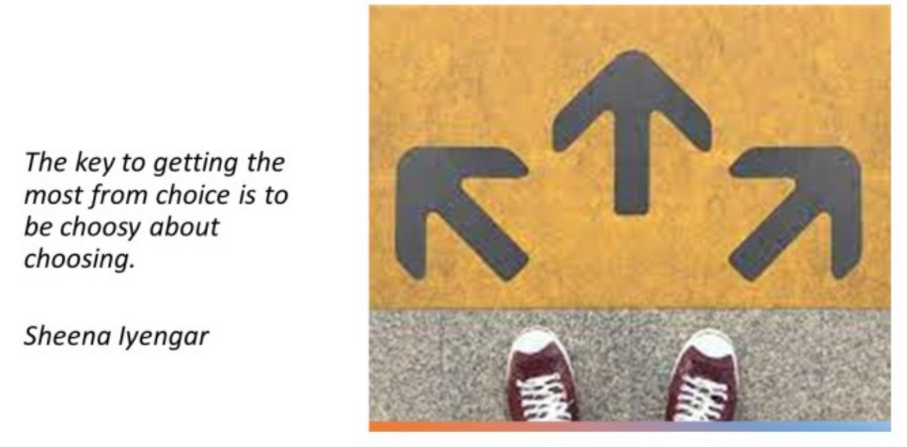
CONCLUSION
  Cultural differences shape our perception of choice.
  Having too many options can lead to decision fatigue and dissatisfaction.
  Choose wisely using logic and reasoning.
  Don’t always rely on your memory to make sound decisions
8

Slide 9

THANK YOU FOR LISTENING
9

